Slide 1
designing for the Transportation market
CONFIDENTIAL: All contents copyright of Illinois Tool Works, Inc. (ITW).
The ITW Photonics Group, Cal Sensors, ITW Linx, Lumex and Opto Diode logos are registered trademarks of ITW, Inc. Copyright © 2013, all rights reserved.

Slide 2
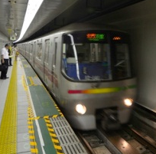



Product Components Ideal for Transportation Applications
As the technology in the transportation market continues to evolve, so do the challenges that face design engineers. Lumex has been providing high-quality components for the transportation for over 30 years.
Lumex is a leader in providing new optoelectronic and display technology specifically designed for performance and endurance, to create feature-rich, high-value product device and instrumentation solutions within focus niches such as:
Automotive
Aerospace
Railway
Personal Water Crafts
Most recently, we have expanded our product
offering to incorporate technologies that can
endure in some of the most hostile operating
environments:
• -40˚C to +85˚C extreme temperature technologies
• LED backlights, able to withstand temperatures up to 100˚C
• High intensity LED displays, able to withstand temperatures up to 105˚C
Design Considerations for Transportation and Automotive Applications
Extreme Temperatures
Long Life Span
Low Power Consumption
Wavelength Sensitivity
High Bright Visibility
Portability
Durability
CONFIDENTIAL: All contents copyright of Illinois Tool Works, Inc. (ITW).
The ITW Photonics Group, Cal Sensors, ITW Linx, Lumex and Opto Diode logos are registered trademarks of ITW, Inc. Copyright © 2013, all rights reserved.

Slide 3
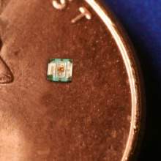
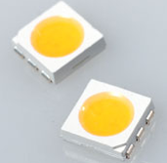
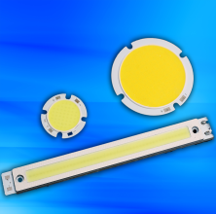
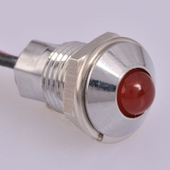
Product Components Ideal for the Transportation Market
0404 Surface-Mount RGB LEDs
Full color surface-mount RGB LED
0404 Packaging – 1.0mm x 1.00mm x 0.25mm
Low current operation (30/40/20 mcd respectively for RGB @ 2mA)
Operating temperature range from -40˚C to +85˚C
Lumex Product Families
High Power LEDs
Ultraviolet LEDs
Thru-Hole & SMD LEDs
Panel & PCB Indicators
LED Displays
LED Arrays
Light Pipes
Infrared Devices
Monochromatic & Color LCDs
PLCC-6, 5050 Package
State-of-the-art high brightness chip technology
3 Dice per LED package
Lead frame / lens casting reliability
Wireless Bond LED Technology
No wire bond and a silicon layer provide enhanced shock and vibration resistance
Superior heat dissipation and light performance
Available in both standard and custom colors and shapes
Available in 3W wireless bond light bar modules and 6W wireless bond round modules in addition to custom colors (including blue) and sizes for 3W, 6W and 9W
LED Panel Indicators (SSI-LXR3616 and SSI-LXR4815 series)
High brightness daylight visibility
Multi-color display capability
Industry-standard connectors
Operating temperature range from -40˚C to +85˚C
CONFIDENTIAL: All contents copyright of Illinois Tool Works, Inc. (ITW).
The ITW Photonics Group, Cal Sensors, ITW Linx, Lumex and Opto Diode logos are registered trademarks of ITW, Inc. Copyright © 2012, all rights reserved.
CONFIDENTIAL: All contents copyright of Illinois Tool Works, Inc. (ITW).
The ITW Photonics Group, Cal Sensors, ITW Linx, Lumex and Opto Diode logos are registered trademarks of ITW, Inc. Copyright © 2013, all rights reserved.

Slide 4
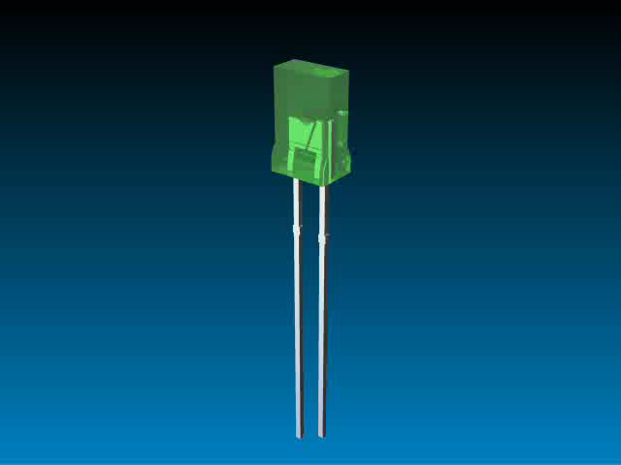
Multiple Technologies…
One Product Solution
In today’s competitive marketplace, many engineers are finding that many standard technologies do not meet all of their needs.
More and more, design engineers are recognizing that an application-specific solution will offer the best result for more complex design needs.
Lumex has proven success at translating initial design concepts and turning them into reality.
Whether addressing a current
design challenge or integrating
multiple components into one
sub-assembly, Lumex will work
with you from initial prototype
through final production.
Lumex offers experience,
quality and innovative originality
to help bring products to market
faster and help provide that
competitive edge.
Benefits of
Value Add Solutions
Focus on application needs
Stand out from competition
Enhanced reliability
Speed time to market
Reduced labor costs
Faster ROI
Full plug ‘n play solution
Engineering know-how that acts as an extension of your own team
CONFIDENTIAL: All contents copyright of Illinois Tool Works, Inc. (ITW).
The ITW Photonics Group, Cal Sensors, ITW Linx, Lumex and Opto Diode logos are registered trademarks of ITW, Inc. Copyright © 2013, all rights reserved.

